Slide 1

Chapter 8 :: Subroutines and Control Abstraction
Programming Language Pragmatics
Michael L. Scott
Copyright © 2009 Elsevier

Slide 2
Review Of Stack Layout
Allocation strategies
  Static
    Code
    Globals
    Own variables
    Explicit constants (including strings, sets, other aggregates)
    Small scalars may be stored in the instructions themselves
Copyright © 2009 Elsevier

Slide 3
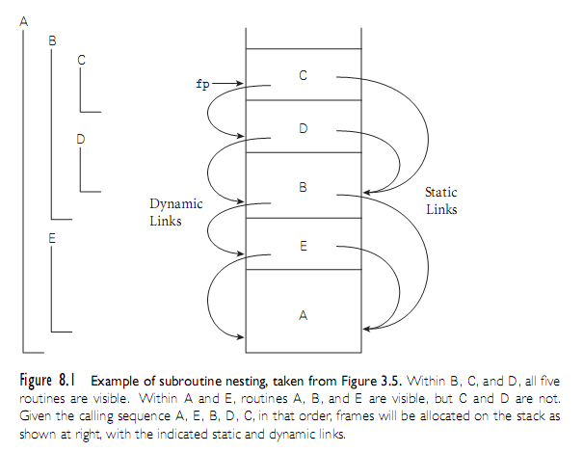
Review Of Stack Layout
Copyright © 2009 Elsevier

Slide 4
Review Of Stack Layout
Allocation strategies (2)
  Stack
    parameters
    local variables
    temporaries
    bookkeeping information
  Heap
    dynamic allocation
Copyright © 2009 Elsevier

Slide 5
Review Of Stack Layout
Contents of a stack frame
  bookkeeping
    return PC (dynamic link)
    saved registers
    line number
    saved display entries
    static link
  arguments and returns
  local variables
  temporaries
Copyright © 2009 Elsevier

Slide 6
Calling Sequences
Maintenance of stack is responsibility of calling sequence and subroutine prolog and epilog – discussed in Chapter 3
  space is saved by putting as much in the prolog and epilog as possible
  time may be saved by putting stuff in the caller instead, where more information may be known
    e.g., there may be fewer registers IN USE at the point of call than are used SOMEWHERE in the callee
Copyright © 2009 Elsevier

Slide 7
Calling Sequences
Common strategy is to divide registers into caller-saves and callee-saves sets
  caller uses the "callee-saves" registers first
  "caller-saves" registers if necessary
Local variables and arguments are assigned fixed OFFSETS from the stack pointer or frame pointer at compile time
  some storage layouts use a separate arguments pointer
  the VAX architecture encouraged this
Copyright © 2009 Elsevier

Slide 8
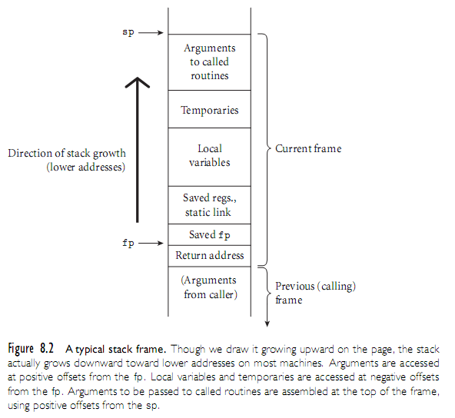
Calling Sequences
Copyright © 2009 Elsevier

Slide 9
Calling Sequences (C on MIPS)
Caller
  saves into the temporaries and locals area any caller-saves registers whose values will be needed after the call
  puts up to 4 small arguments into registers $4-$7 (a0-a3)
    it depends on the types of the parameters and the order in which they appear in the argument list
  puts the rest of the arguments into the arg build area at the top of the stack frame
  does jal, which puts return address into register ra and branches
    note that jal, like all branches, has a delay slot
Copyright © 2009 Elsevier

Slide 10
Calling Sequences (C on MIPS)
In prolog, Callee
  subtracts framesize from sp
  saves callee-saves registers used anywhere inside callee
  copies sp to fp
In epilog, Callee
  puts return value into registers (mem if large)
  copies fp into sp (see below for rationale)
  restores saved registers using sp as base
  adds to sp to deallocate frame
  does jra
Copyright © 2009 Elsevier

Slide 11
Calling Sequences (C on MIPS)
After call, Caller
  moves return value from register to wherever it's needed (if appropriate)
  restores caller-saves registers lazily over time, as their values are needed
All arguments have space in the stack, whether passed in registers or not
The subroutine just begins with some of the arguments already cached in registers, and 'stale' values in memory
Copyright © 2009 Elsevier

Slide 12
Calling Sequences (C on MIPS)
This is a normal state of affairs; optimizing compilers keep things in registers whenever possible, flushing to memory only when they run out of registers, or when code may attempt to access the data through a pointer or from an inner scope
Copyright © 2009 Elsevier

Slide 13
Calling Sequences (C on MIPS)
Many parts of the calling sequence, prologue, and/or epilogue can be omitted in common cases
  particularly LEAF routines (those that don't call other routines)
    leaving things out saves time
    simple leaf routines don't use the stack - don't even use memory – and are exceptionally fast
Copyright © 2009 Elsevier

Slide 14
Parameter Passing
Parameter passing mechanisms have three basic implementations
  value
  value/result (copying)
  reference (aliasing)
  closure/name
Many languages (e.g., Pascal) provide value and reference directly
Copyright © 2009 Elsevier

Slide 15
Parameter Passing
C/C++: functions
  parameters passed by value (C)
  parameters passed by reference can be simulated with pointers (C)
    void proc(int* x,int y){*x = *x+y } …
    proc(&a,b);
  or directly passed by reference (C++)
    void proc(int& x, int y) {x = x + y }
    proc(a,b);
Copyright © 2009 Elsevier

Slide 16
Parameter Passing
Ada goes for semantics: who can do what
  In: callee reads only
  Out: callee writes and can then read (formal not initialized); actual modified
  In out: callee reads and writes; actual modified
Ada in/out is always implemented as
  value/result for scalars, and either
  value/result or reference for structured objects
Copyright © 2009 Elsevier

Slide 17
Parameter Passing
In a language with a reference model of variables (Lisp, Clu), pass by reference (sharing) is the obvious approach
It's also the only option in Fortran
  If you pass a constant, the compiler creates a temporary location to hold it
  If you modify the temporary, who cares?
Call-by name is an old Algol technique
  Think of it as call by textual substitution (procedure with all name parameters works like macro) - what you pass are hidden procedures called THUNKS
Copyright © 2009 Elsevier

Slide 18
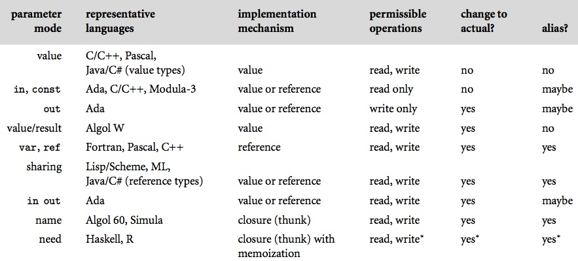
Parameter Passing
Figure 8.3 Parameter passing modes.
Copyright © 2009 Elsevier

Slide 19
Generic Subroutines and Modules
Generic modules or classes are particularly valuable for creating containers: data abstractions that hold a collection of objects
Generic subroutines (methods) are needed in generic modules (classes), and may also be useful in their own right
Copyright © 2009 Elsevier

Slide 20
Exception Handling
What is an exception?
  a hardware-detected run-time error or unusual condition detected by software
Examples
  arithmetic overflow
  end-of-file on input
  wrong type for input data
  user-defined conditions, not necessarily errors
Copyright © 2009 Elsevier

Slide 21
Exception Handling
What is an exception handler?
  code executed when exception occurs
  may need a different handler for each type of exception
Why design in exception handling facilities?
  allow user to explicitly handle errors in a uniform manner
  allow user to handle errors without having to check these conditions
  explicitly in the program everywhere they might occur
Copyright © 2009 Elsevier

Slide 22
Coroutines
Coroutines are execution contexts that exist concurrently, but that execute one at a time, and that transfer control to each other explicitly, by name
Coroutines can be used to implement
  iterators (Section 6.5.3)
  threads (to be discussed in Chapter 12)
Because they are concurrent (i.e., simultaneously started but not completed), coroutines cannot share a single stack
Copyright © 2009 Elsevier

Slide 23
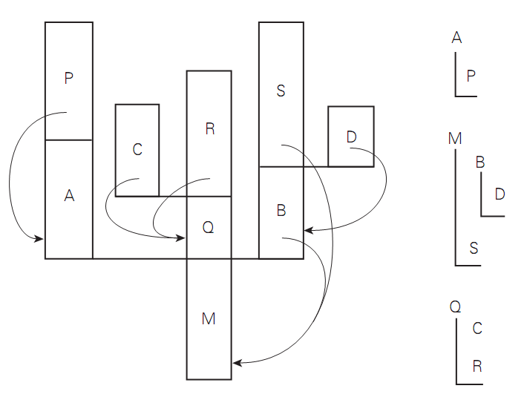
Coroutines
Figure 8.6 A cactus stack. Each branch to the side represents the creation of a coroutine ( A, B, C, and D). The static nesting of blocks is shown at right. Static links are shown with arrows. Dynamic links are indicated simply by vertical arrangement: each routine has called the one above it. (Coroutine B, for example, was created by the main program, M. B in turn called subroutine S and created coroutine D.)
Copyright © 2009 Elsevier

